Slide 1
Evacuation bottlenecks in flooding events
Fabio Crameri & Marcel Thielmann

Slide 2
Motivation
Beaches are preferred human settlements
Tsunamis & flooding
Need for efficient evacuation
Life security vs. economy
We want the credit points!

Slide 3
Method
Numerical modelling (MATLAB)
Continuous model: Agents are modelled separately

Slide 4
Forces on agents
Psychological/social forces
Surrounding agents
Walls
Exits
Flood
Physical forces (normal & tangential)
Surrounding agents
Walls
repulsive / attractive
Helbing et al. 2000

Slide 5
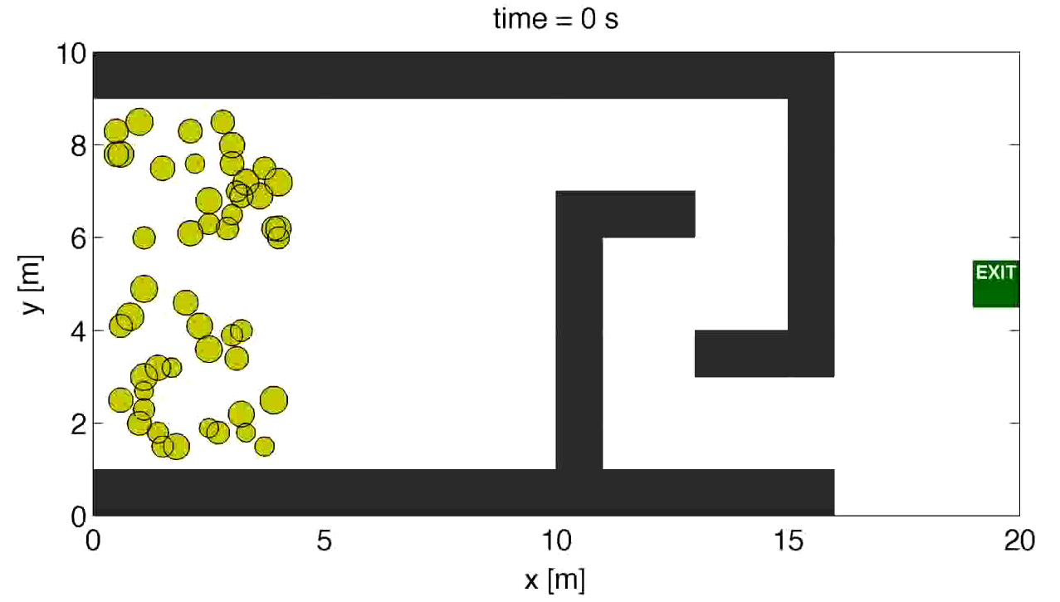
Exits
Direct, straight, attractive force towards the exit

Slide 6
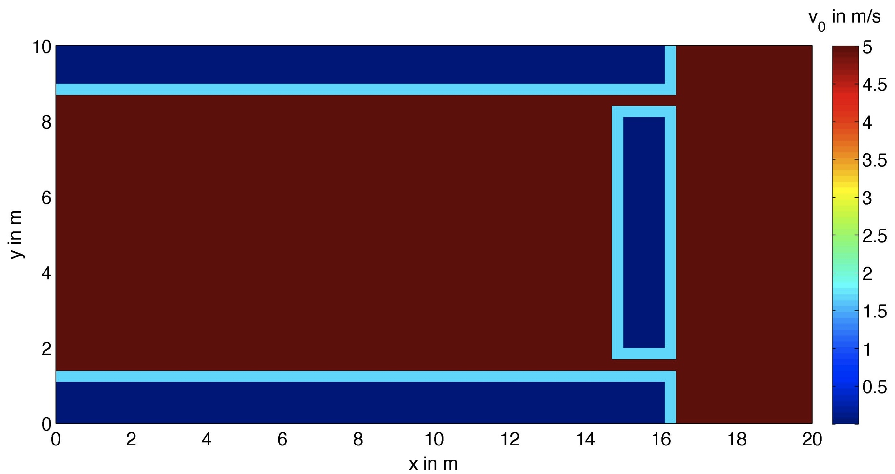
Exits
Agents do not behave in a realistic manner
fast marching alghorithm (Sethian 1996)
Buildings are represented as regions with low velocity

Slide 7
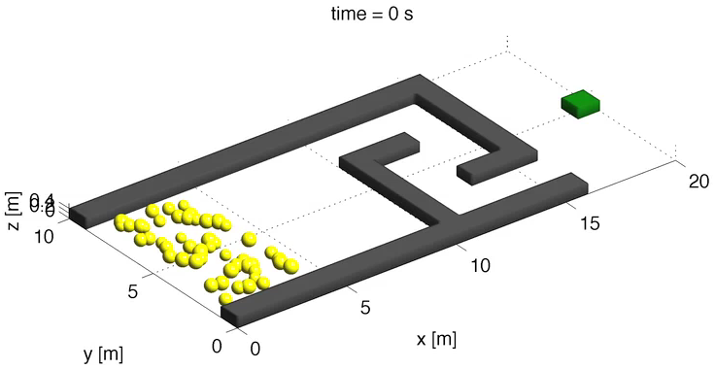
Exits
Fast marching algorithm (Sethian 1996)

Slide 8
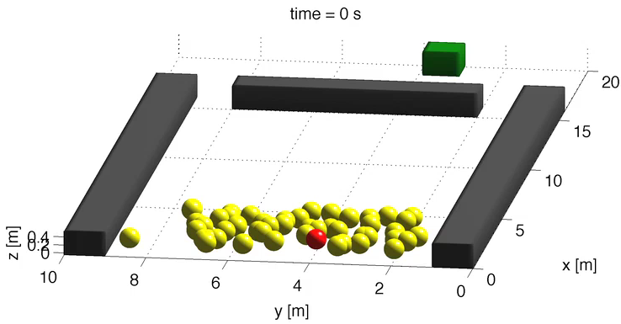
Exits
Two exits

Slide 9
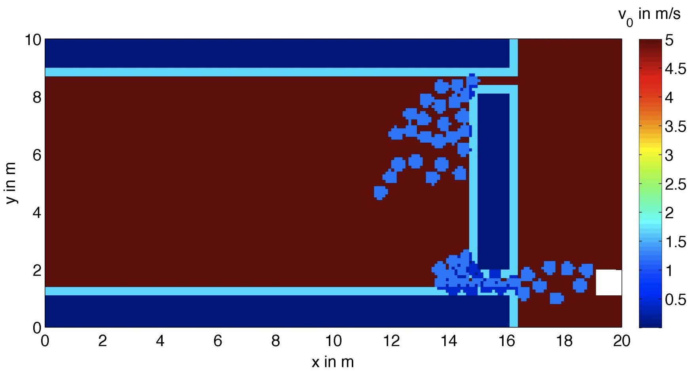
Exits
Agents chose only one exit: again not realistic
agent-weighted velocity map

Slide 10
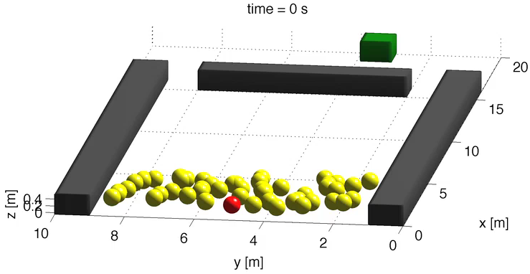
Exits
Two exits: taking surrounding agents into account

Slide 11

Going big
55x101 m, resolved down to 0.1 m and: 1000 agents

Slide 12
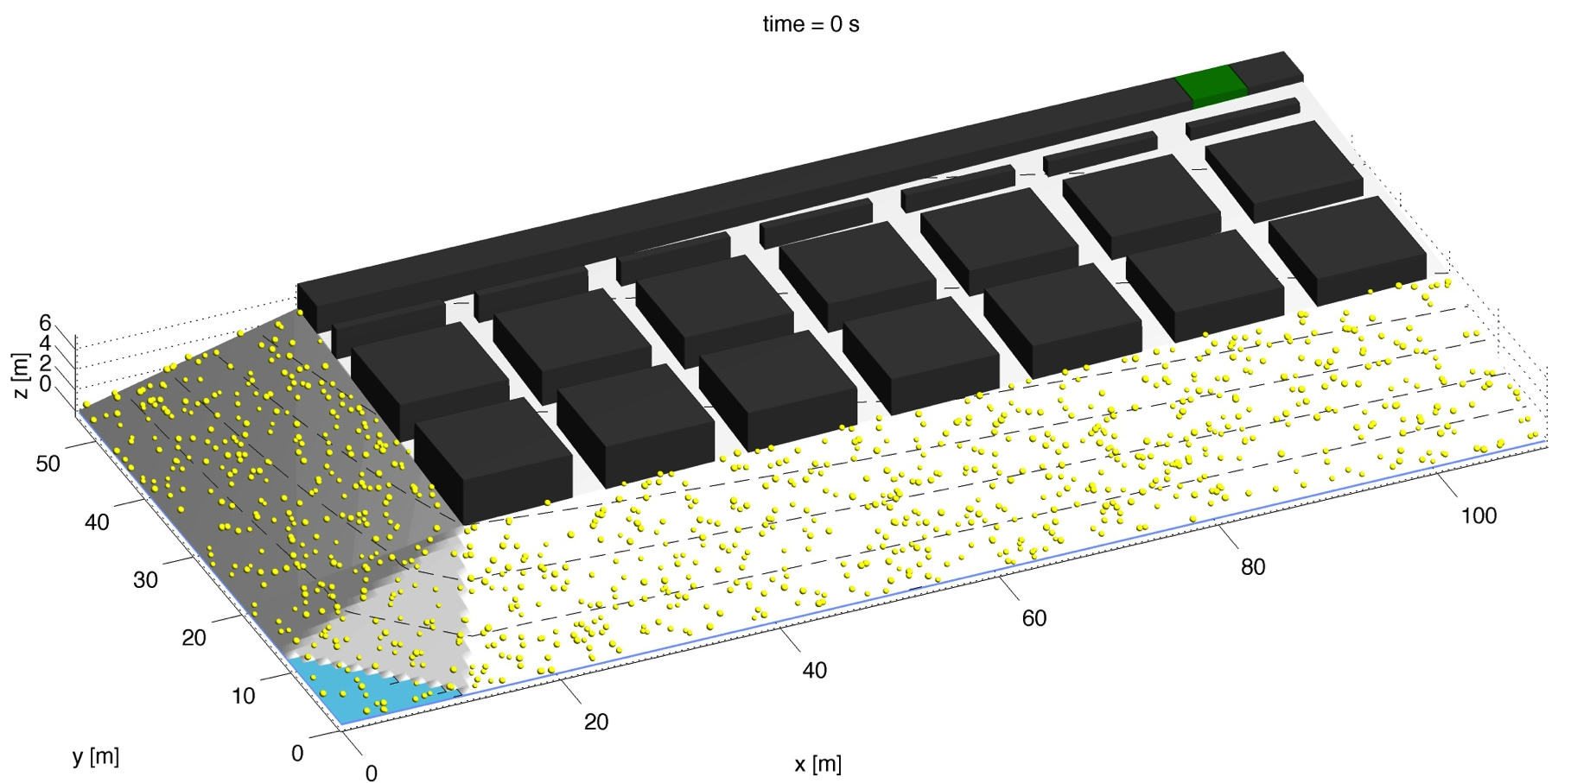
Model setups
street width: 1 m 7 m

Slide 13
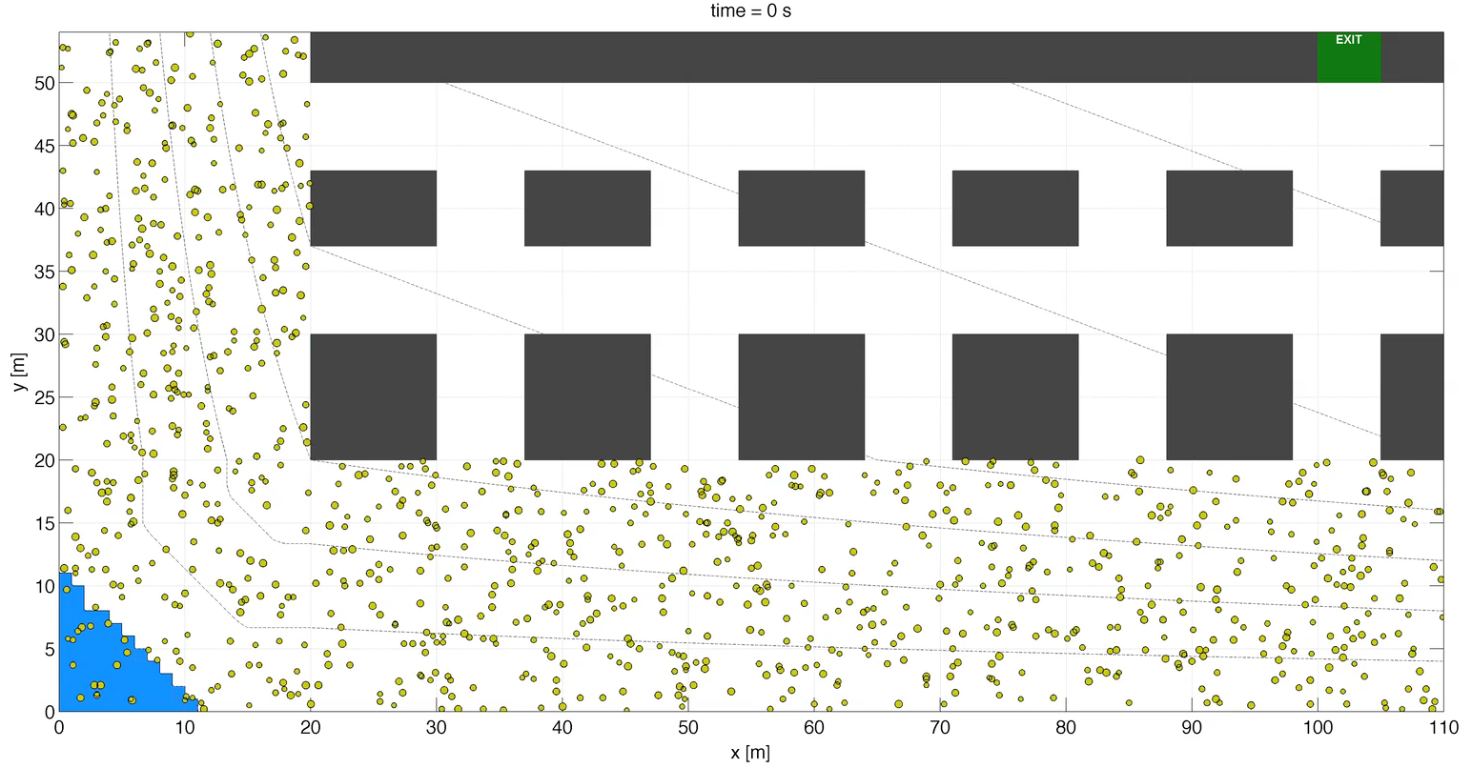
Beach evacuation: 7 m wide spacing

Slide 14
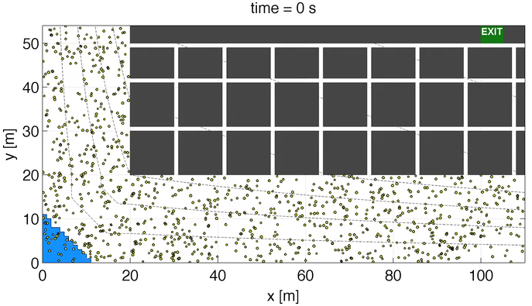
Beach evacuation: 1 m wide spacing

Slide 15
Analysis
3 m wide streets is sufficient

Slide 16
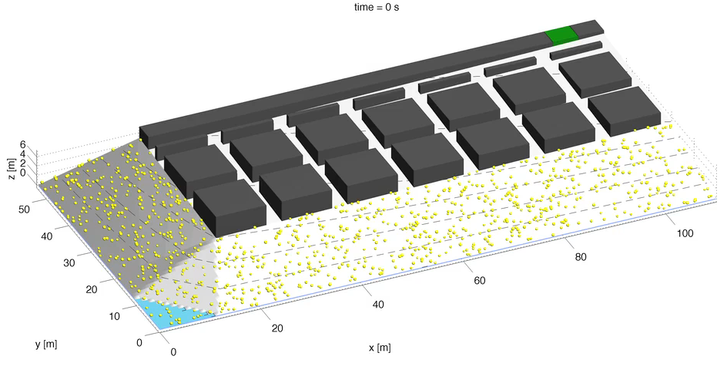
Beach evacuation: 3 m wide spacing
Visualization is also computationally expensive!

Slide 17
Conclusions
Computationally efficient codes needed for large scale escape panic modelling
Fastest path formulation increases realistic behaviour
...including agents into this formulation, too.
In our model, 3 m wide escape roads are sufficient for an effective evacuation
Thank you!

